Slide 1

Project Space 4.0
File Sharing in Multi cloud platforms
Sharing of digital information via various cloud platforms to increase accessibility and efficiency during collaboration.
01

Slide 2

02
TEAM NAME : CLOUD CREW
MENTORS:
BOBBY SIR
SURYA ASHOK SIR
TEAM MENTORS
AND
TEAM MEMBERS
TEAM MEMBERS:
CHIRUKOTI SAI LIKITH
DULAM YASHWANT SATYA VIGNESH
KONA LOKESH
KANCHARLA CHARAN

Slide 3

Description
01.
Introduction
07.
Proof of the project
02.
Purpose
08.
Analysis
03.
Technologies Used
09.
Real time applications
Overview
04.
Implementation
10.
Conclusion
05.
Objectives
06.
Theoretical framework
03

Slide 4

04
Introduction
File sharing:
File sharing is a practice of sharing or offering access tom digital information or resources including documents , Multimedia , computer programs and images .
It is the private or public distribution of data in network with different levels of sharing privileges.

Slide 5
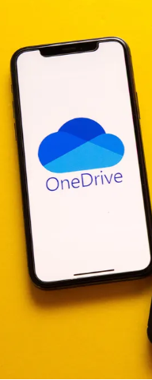
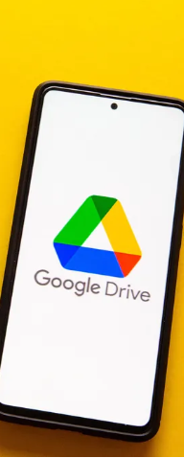
05
Purpose
01.
The purpose of file sharing in a cloud platform is to enable users to store, access, and share files from anywhere and at any time, as long as they have an internet connection. Cloud platforms provide a convenient way to store data and applications on remote servers, which can be accessed from any device with internet connectivity.
02.
File sharing allows several people to use the same file data. Some users may be able to create and modify files depending on access permissions, while others may only have read access or even no access.
ONEDRIVE
GOOGLE DRIVE

Slide 6
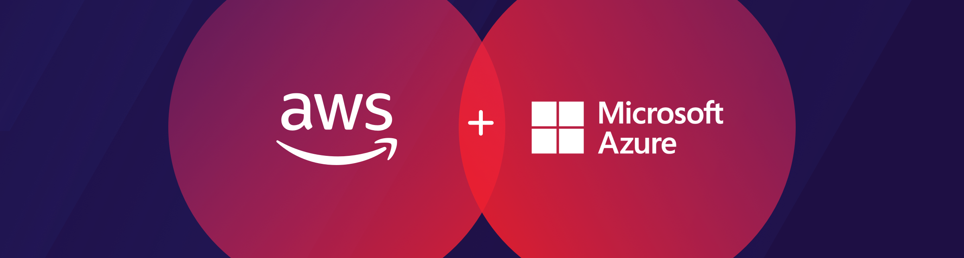
06
AMAZON WEB SERVICES
AZURE
Technologies Used
01.
AMAZON WEB SERVICES
02.
MICROSOFT AZURE
The AWS Management Console is a web application that comprises and refers to a broad collection of service consoles for managing AWS resources.
Azure is Microsoft's public cloud platform. Azure offers a large collection of services, which includes platform as a service (PaaS), infrastructure as a service (IaaS), and managed database service capabilities

Slide 7
07
Implementation
File sharing can be done in different cloud platforms and also the files can be shared between different cloud platforms such as AWS , MICROSOFT AZURE , GOOGLE CLOUD and PRIVATE CLOUD
Phase 01
Phase 02
Phase 03
FILE SHARING ACROSS MULTIPLE REGIONS IN AWS CLOUD PLATFORM USING VPC PEERING.
[REGION TO REGION]
FILE TRANSFER BETWEEN THE AZURE VM AND AZURE LOCAL STORAGE.
[AZURE FILE SYNC SERVICE TO VM]
FILE TRANSFER FROM MICROSOFT AZURE TO AMAZON WEB SERVOCES(AWS).
[CLOUD TO CLOUD TRANSFER]

Slide 8
08
Objectives
The Second Objective
The main objective of our project is to establish an interconnection across different cloud platforms in order to share the resources [files] between various users across the world .
Creation of the virtual machine in AZURE and accessing the files from the local storage account .
Our main objective is to transfer the files from the storage account to the new virtual machine and accessing the data
The First Objective
The Third Objective
Having an interconnection between different cloud platforms like AWS and AZURE .
Our main objective is to have a sharing connecion between two cloud platforms and transfer of files for accessing the data which is to be required
For establishing the file transfer between one region to another region in the AWS cloud platform .
Our main objective is to access the files from different regions by having a connection between the regions .

Slide 9
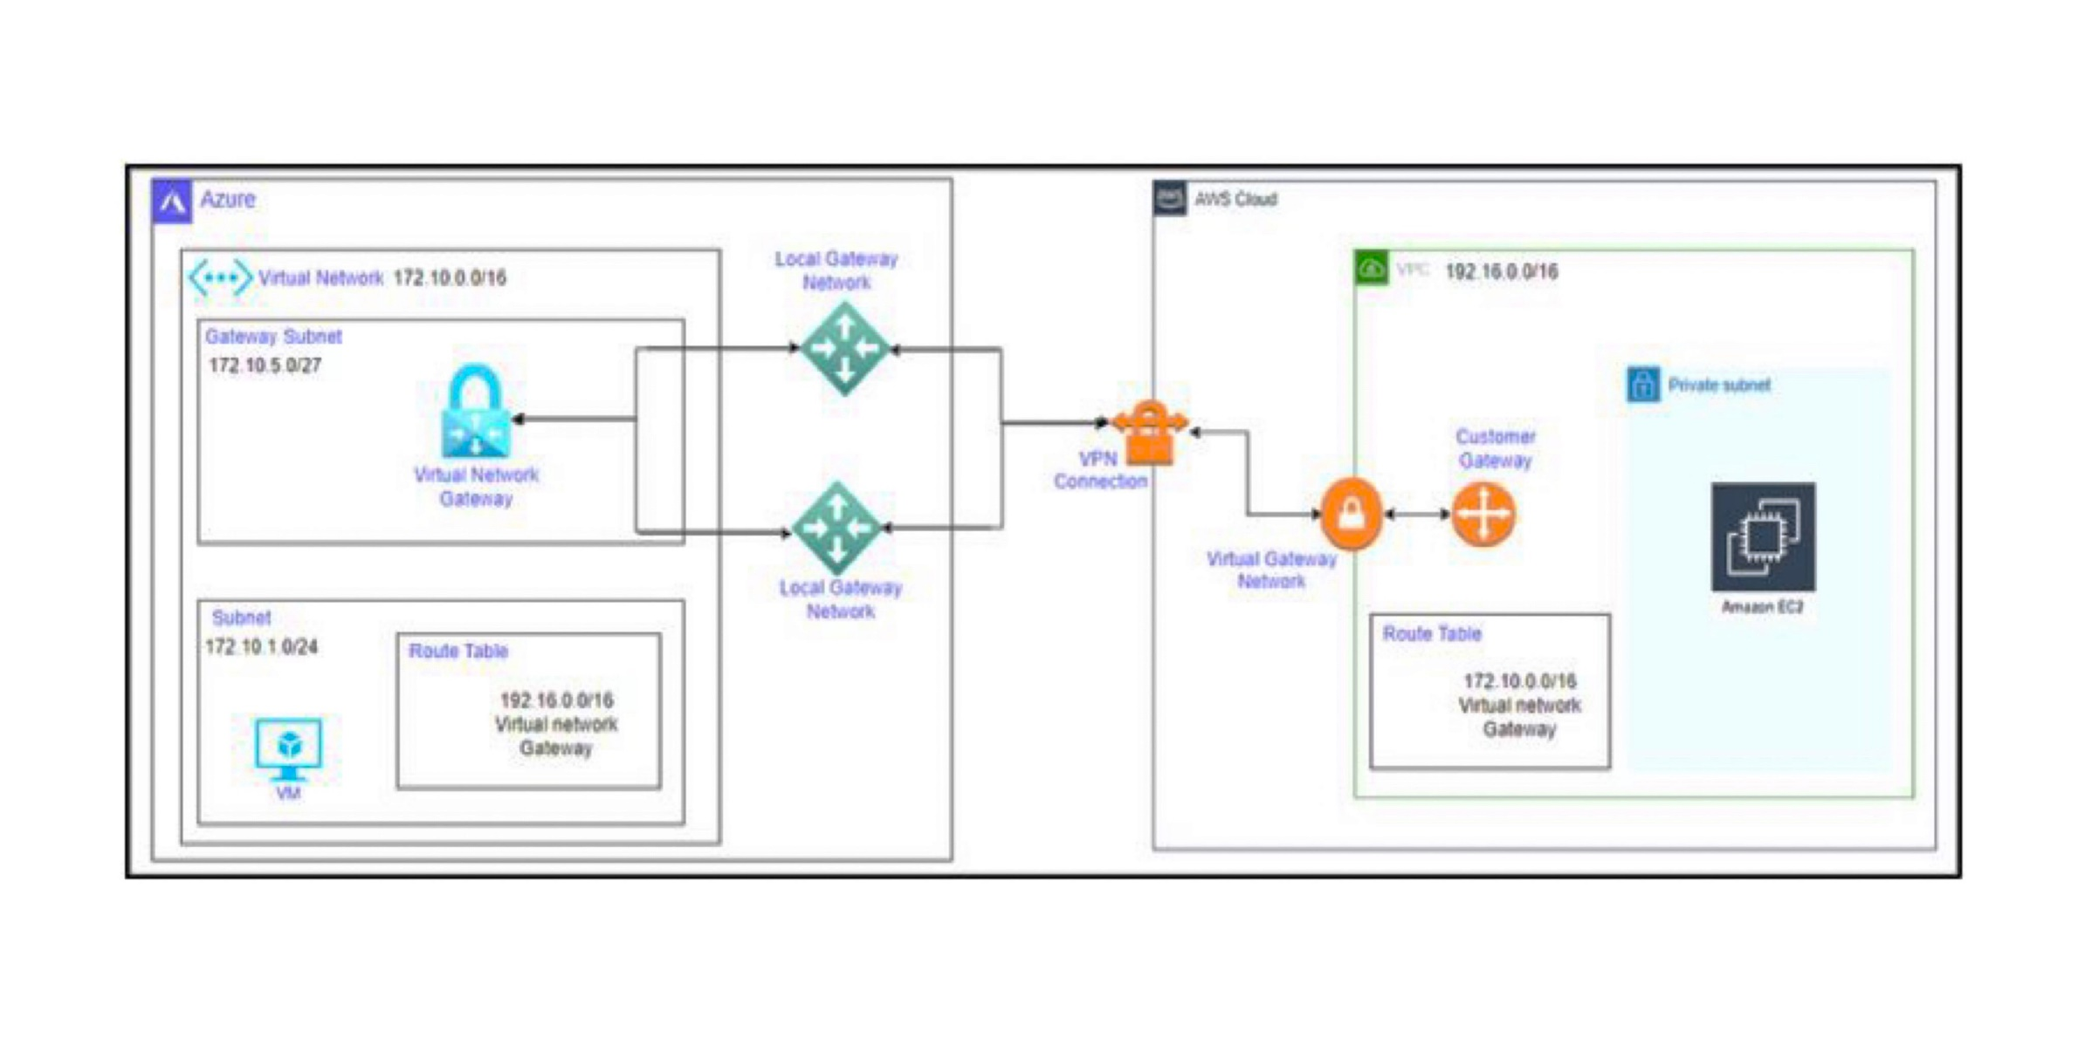
09
Overview
Establishing the connection between the two cloud platforms by having the VPN connection between the different cloud platforms and perform the individual tasks in both platforms . peering connection can be done and have a free acessabilty between the cloud platforms .
Theoretical Framework
Establishing connections
AWS TRANSIST GATEWAY and AZURE VPN GATEWAY can be virtually connected by means of internet having a VPN connection between them .
After having the connection the instance generation can be done in AWS and resource groups can be done in AZURE .
After the establishing of he connections , ping can be done and all the remaining methods can be done in a manner .

Slide 10




12
REAL TIME APPLICATIONS
Data backup and disaster recovery
Collaboration and workflow management
data can be securely backed up and protected in case of any data loss or disaster.
Financial services organizations often have teams working together on complex projects.
File sharing allows multiple people to work on the same document or project simultaneously
The entertainment and media industry generates a vast amount of data, from videos to audio files. Cloud-based file sharing platforms provide a reliable and secure way to store and access this data from anywhere
Financial services
Media and Entertainment

Slide 11
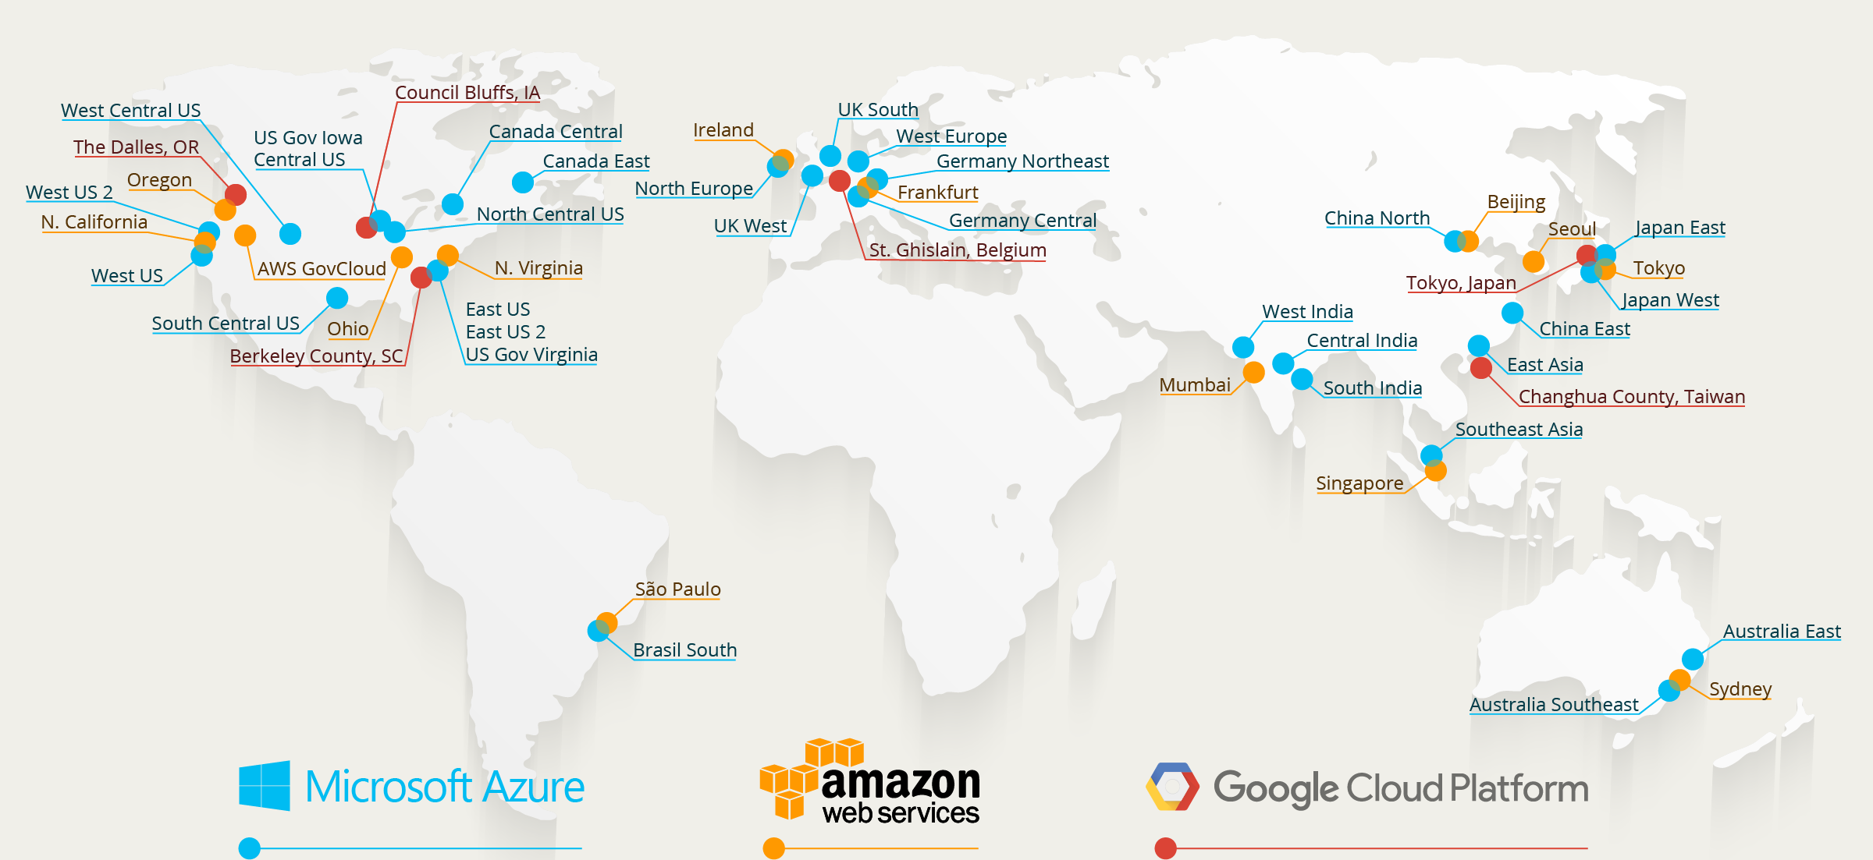
Regions across the world
13
135+
320+
REGIONS
Availabilty zones

Slide 12

14
CONCLUSION
In conclusion, using file sharing from Azure to AWS EFS can provide organizations with a powerful solution for sharing data between two different cloud platforms. By leveraging the scalability and performance of AWS EFS, organizations can reduce data transfer costs, improve application performance, and enable cross-cloud data sharing. However, there are also some limitations to consider, such as network latency, security and compliance, configuration complexity, and cost. Organizations must carefully evaluate their needs and resources before implementing this approach, and follow best practices for file sharing to ensure data protection, performance optimization, and troubleshooting. With the right strategy and expertise, file sharing from Azure to AWS EFS can be a valuable tool for hybrid cloud architectures, multi-cloud strategies, and cloud migration scenarios.

Slide 13
Thank You
SUPPORTED BY @TECHNICAL HUB

Slide 14
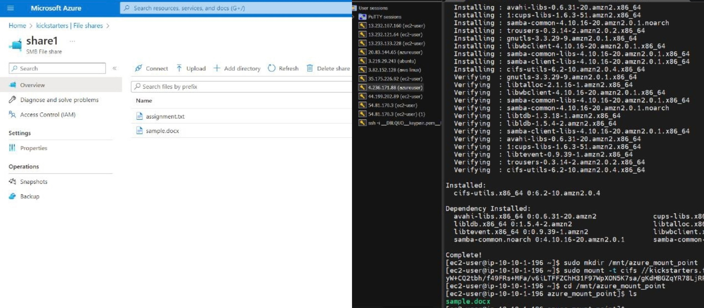
PROOF OF THE PROJECT 10
We have successfully shared the files from AZURE cloud platform to AWS and Vice versa

